Slide 1
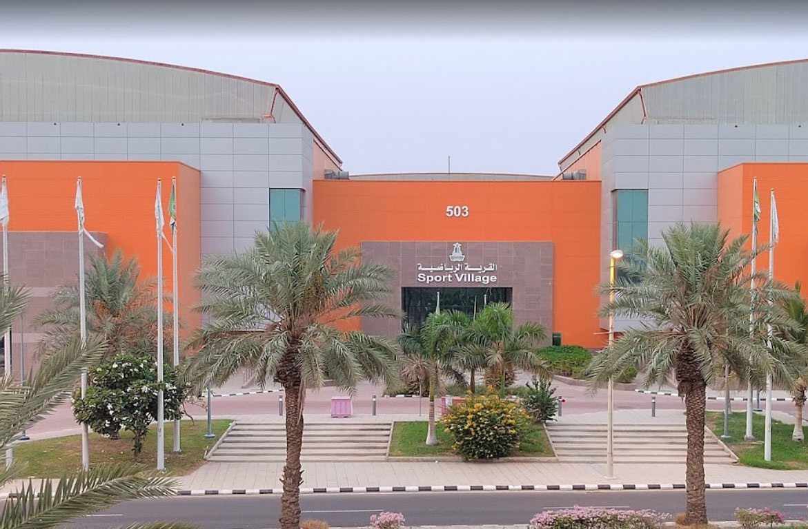





KAU SV
PROJECT
2023/11/
Presentation by:
Faisal Hussain
Abdullah Alharbi
Amr Ashraf

Slide 2

Purpose of the project
The sports village is an important part of the King Abdulaziz university since it holds all physical activities, for an important facility it needs an app to maximize the efficiency and connection between the visitor and host

Slide 3
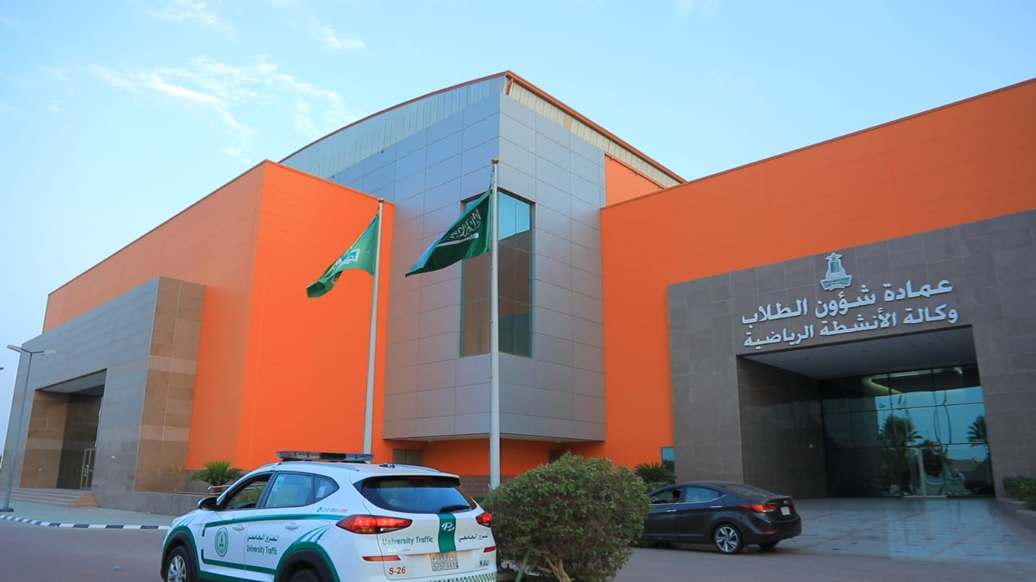


Goals and Objectives
Easy to apply
Arrange events
Promote events
Increase participation

Slide 4

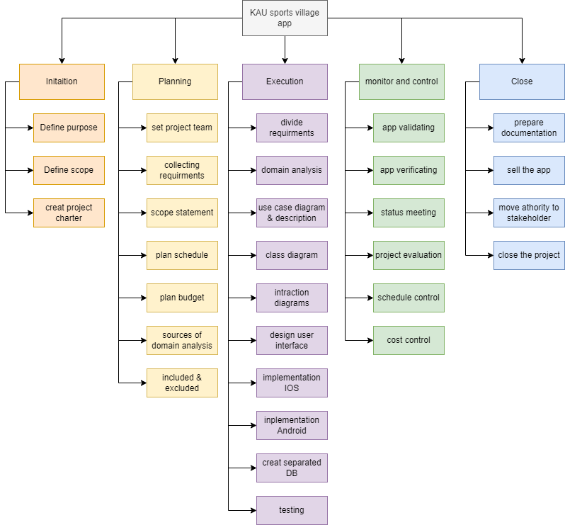
Work Breakdown Structure

Slide 5


Initiation
Planning
Define Purpose
Set project team
Plan schedule
Define Scope
Collecting requirements
Plan budget
Creat project charter
Scope statement
sources of domain
analysis
Included & Excluded

Slide 6

Excution
Divide requirements
Class diagram
IOS implementation
Domain analysis
Android implementation
interaction diagrams
Use case diagram
Design user interface
Database Creation
Testing

Slide 7


Monitor and Control
Close
Documentation
App validating
Project evaluation
Sell the app
App verification
Schedule control
Move authority to stakeholder
Status meeting
Cost control
Close the project

Slide 8
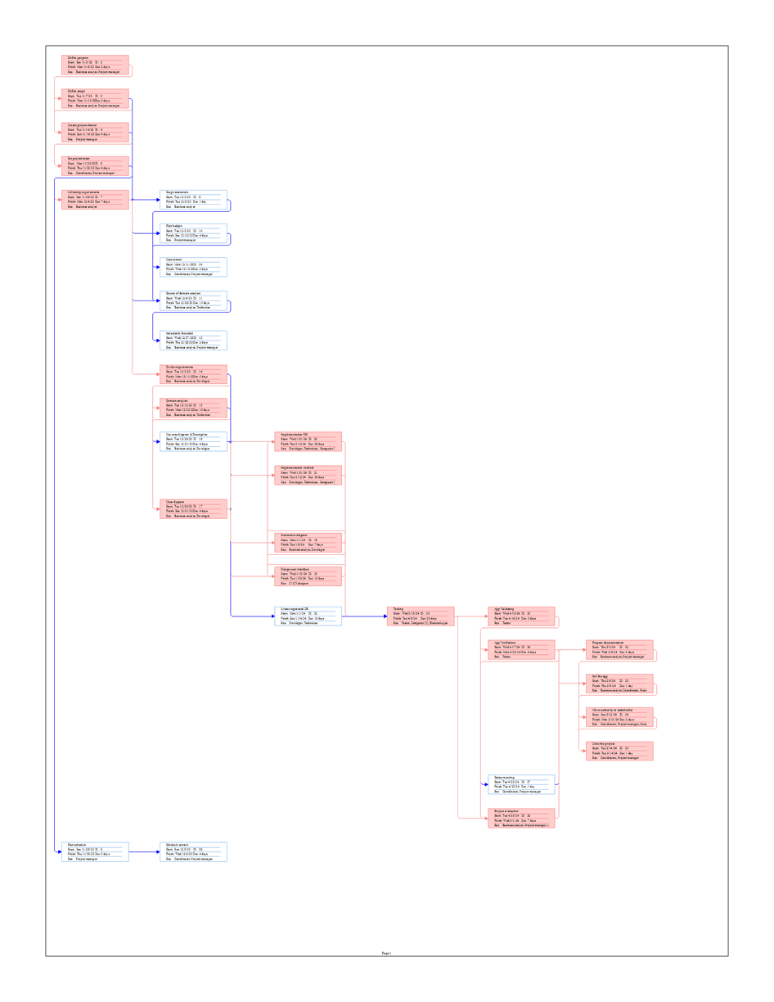
Use of Precedence Diagram Method

Slide 9





Staffing procedure and plan
Define the required positions and their employment type
Define the required time for each position and schedule
Announce about the required positions
Schedule an interviews whit the job seekers
Select the best selection in term of cost per hour and skills

Slide 10
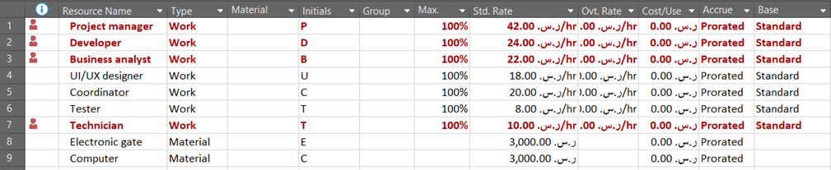
Organizational chart

Slide 11
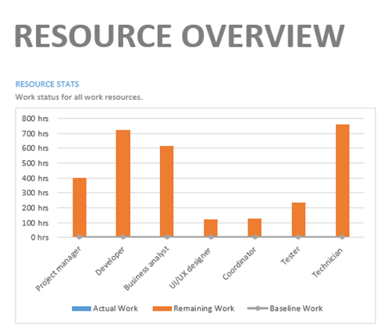
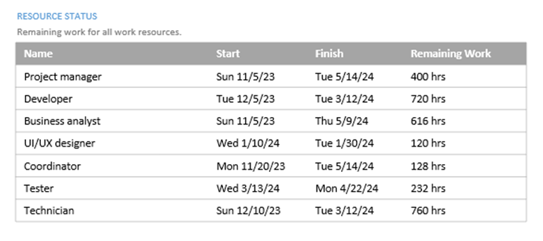
Organizational Histogram

Slide 12
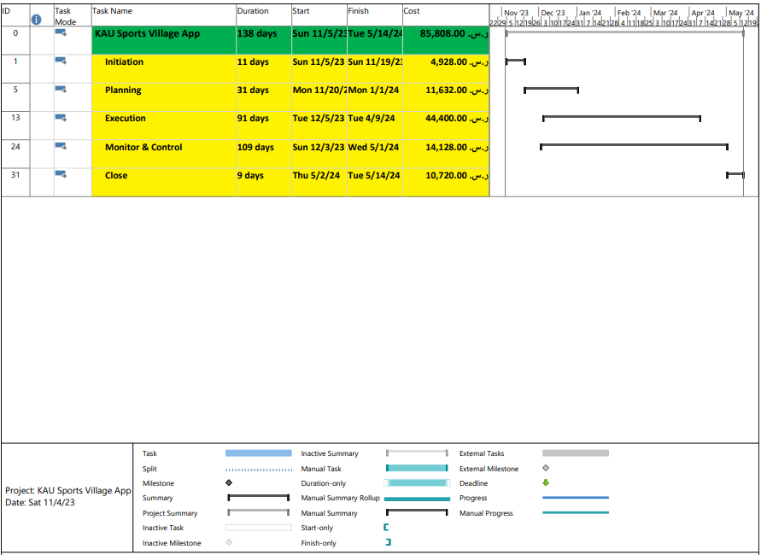
Major Project Milestones

Slide 13
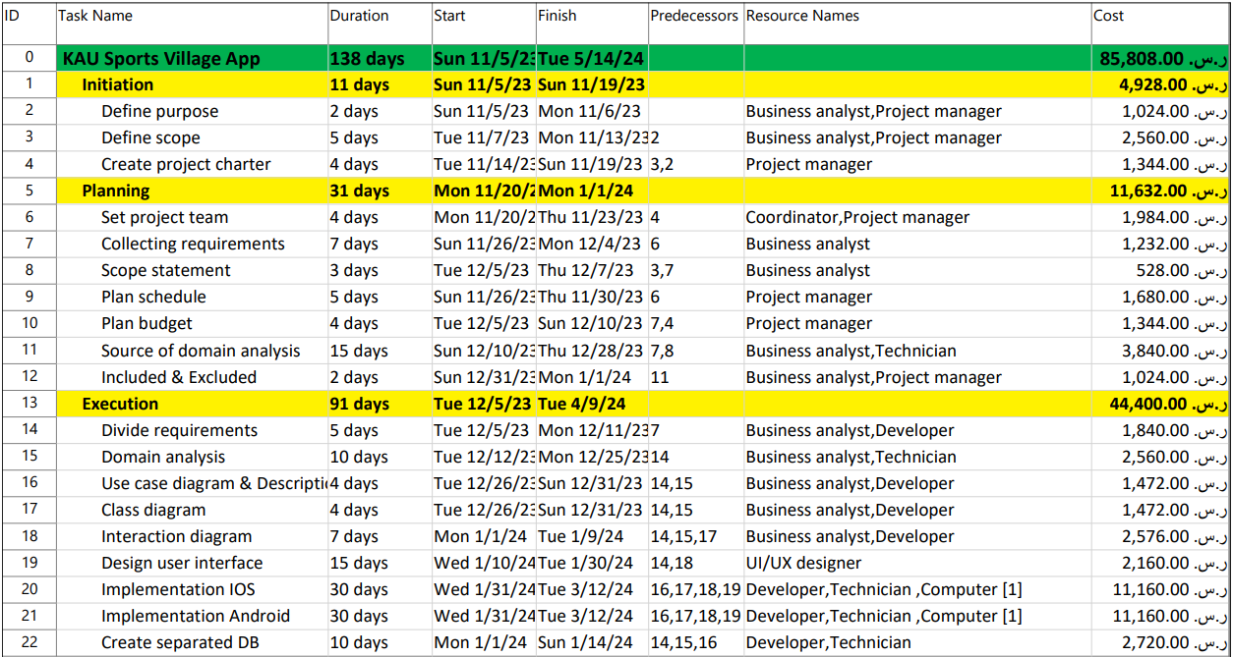
Detailed project schedule

Slide 14
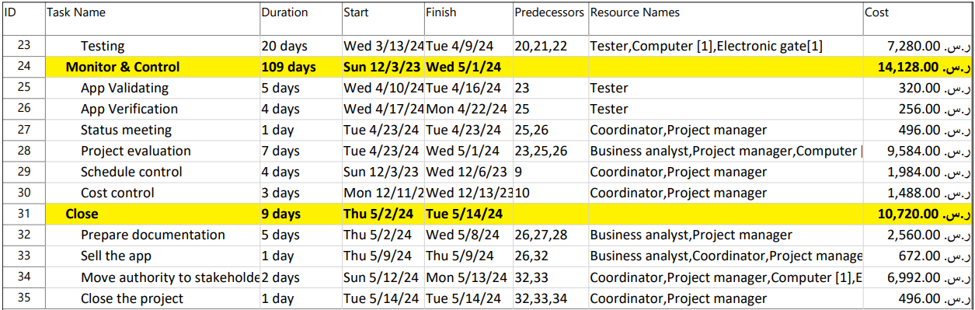
Detailed project schedule

